Slide 1
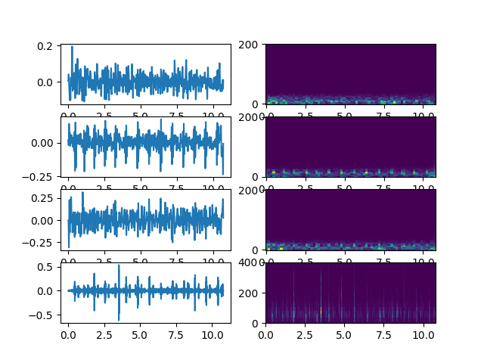
Smartphone data

Slide 2
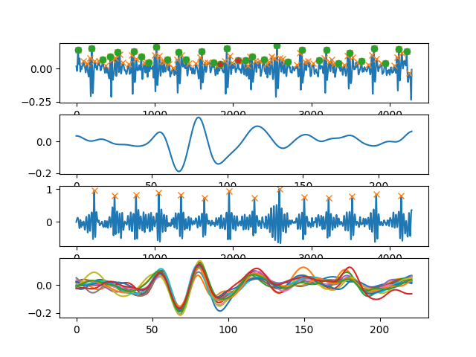
Heartbeat

Slide 3
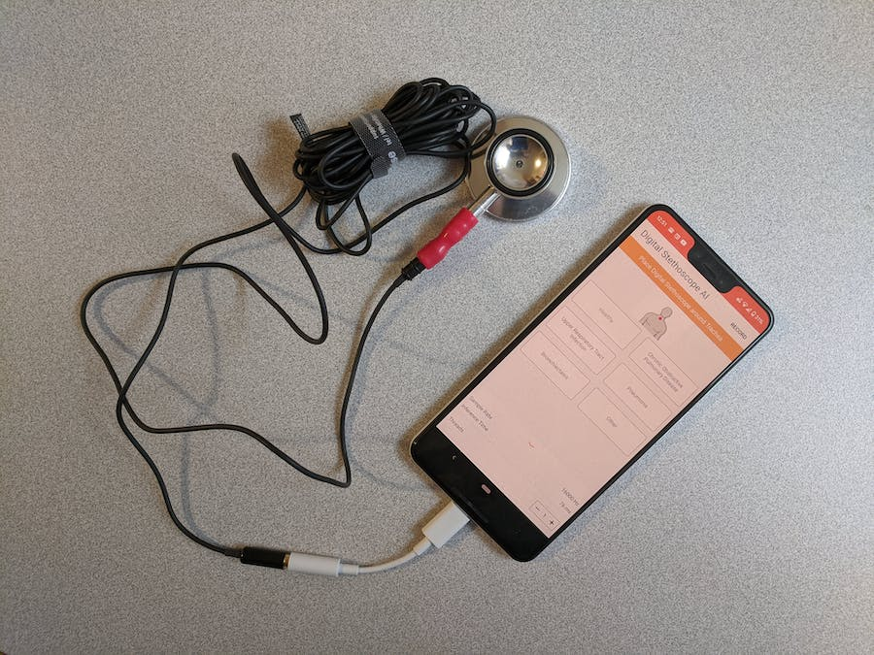
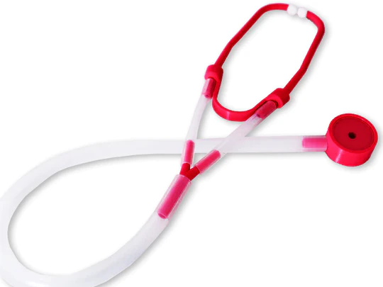
Stethoscope(s)
3M Littmann
Return
Keep, record it with external microphone
Thinklabs stethoscope
Cheap stethoscope

Slide 4
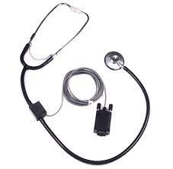
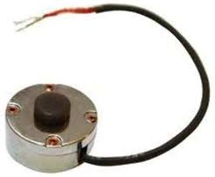
Comparison
Stethoscope is better in term of
SNR
Robust to vibration
Contact Mic
Stethoscope

Slide 5
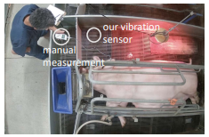
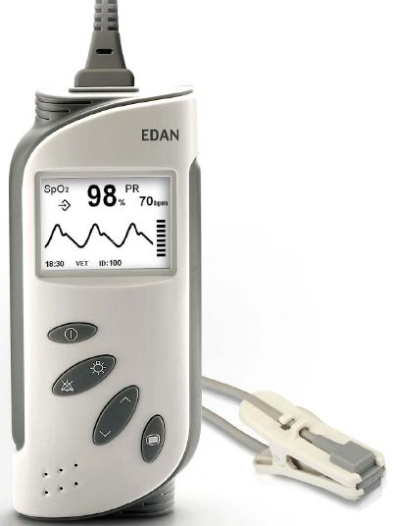


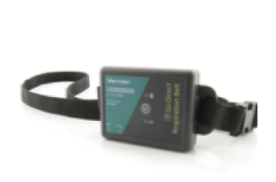
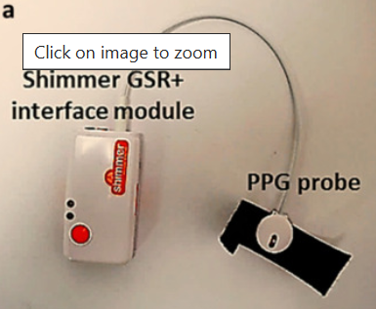
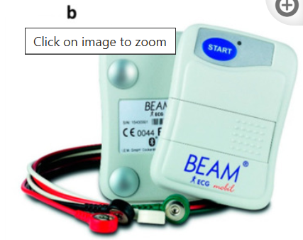
Animal Vital signs
HR
RR
Pulse oximeter
Vision RR
Chest-band RR
PPG sensor
ECG (golden standard)

Slide 6
Stethoscope on smartphone

